Slide 1

Unit – 5 Multiple integral
Mathematics – I (M-I)
GTU # 3110014
Prof. Kartikraj Dhamsaniya
Humanities & Science Department
kartikraj.dhamsaniya@darshan.ac.in
972 41 42 400

Slide 2
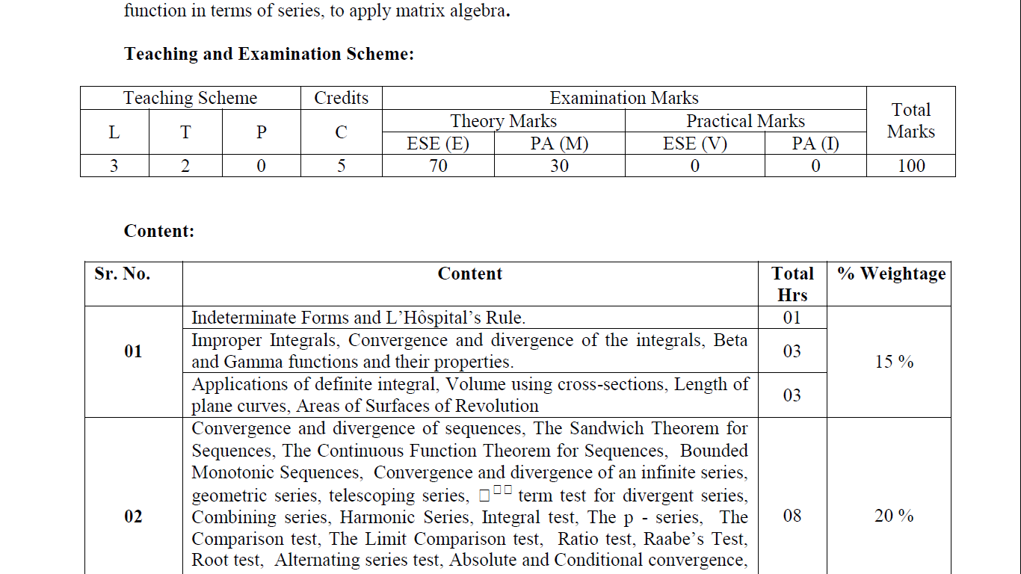
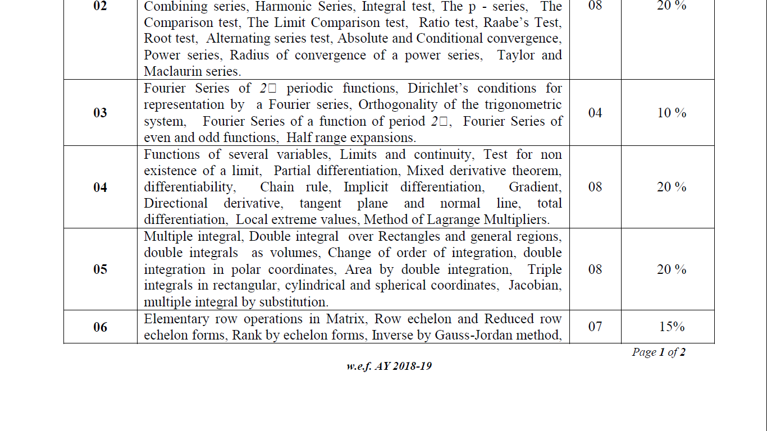
Unit 5 Multiple Integral
Double integral over Rectangles and general regions
Double integrals as volumes
Change of order of integration
Double integration in polar coordinates
Area by double integration
Triple integrals in rectangular
Cylindrical and spherical coordinates
Jacobian
Multiple integral by substitution

Slide 3
Outline
Looping
Introduction
Double Integrals by Direct Integration
Triple Integrals by Direct Integration
Double Integrals over General Region - CC

Slide 4
Introduction

Slide 5
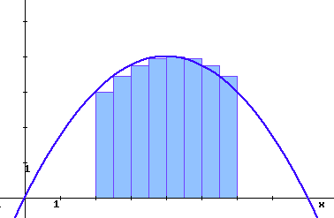
What is Integral?
The integral is usually called the anti-derivative, because integrating is the reverse process of differentiating.
Integration can be used to find areas, volumes, central points and many useful things.
Integration is a way of adding slices to find the whole.

Slide 6
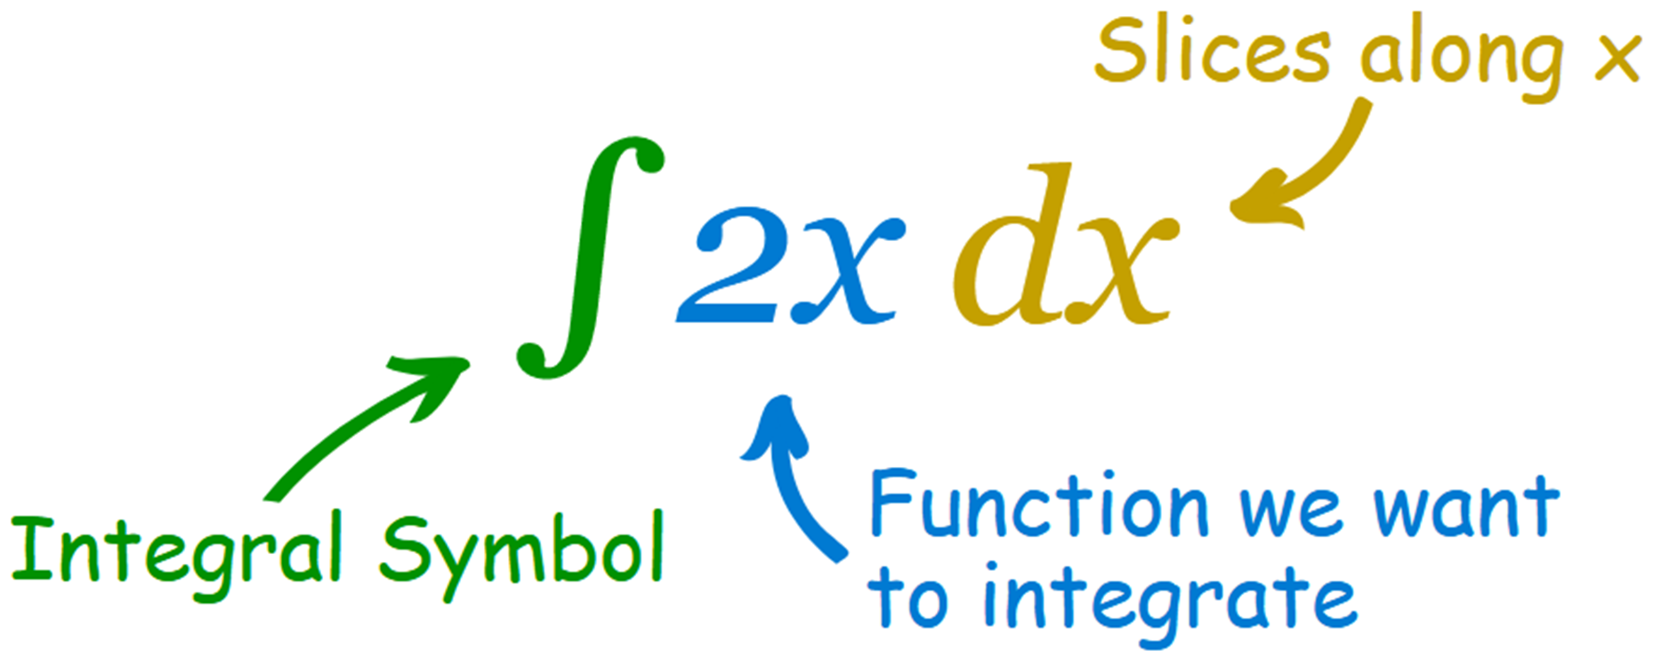

Slide 7
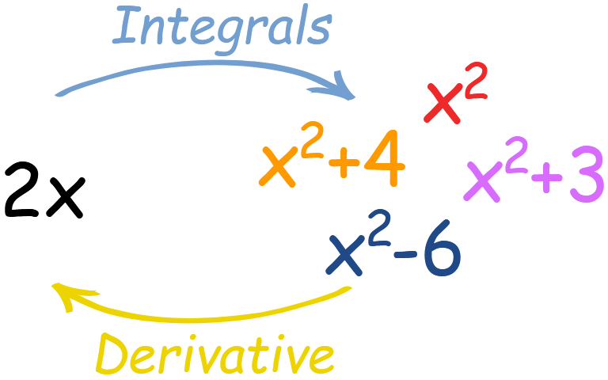
What is +c in Integral?

Slide 8
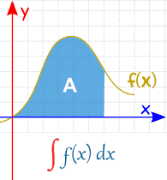
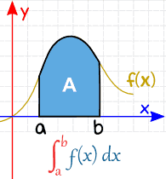
Definite vs Indefinite Integrals
Indefinite Integral
Definite Integral

Slide 9
Double Integrals By Direct Integration

Slide 10
What is Multiple Integral?
The multiple integral is a definite integral of a function of more than one real variable.
For example: f(x, y) or f(x, y, z)
We will study Double integrals & Triple integrals.

Slide 11
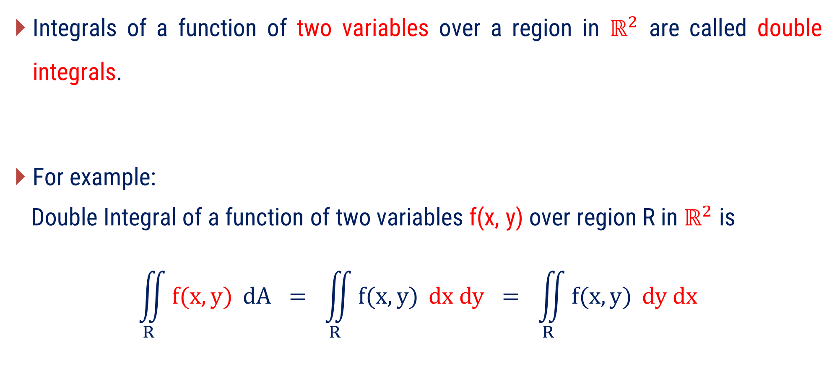
What is Double Integral?
Integrals of a function of two variables over a region in $ℝ^{2}$ are called double integrals.
For example:
Double Integral of a function of two variables f(x, y) over region R in $ℝ^{2}$ is
$$\iint_{R}^{ }{f(x, y)} dA = \iint_{R}^{ }{f(x, y)} dx dy = \iint_{R}^{ }{f(x, y)} dy dx$$

Slide 12
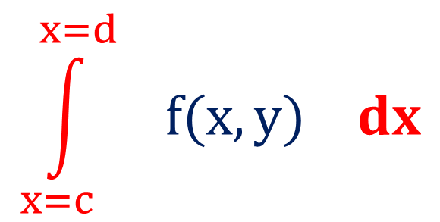

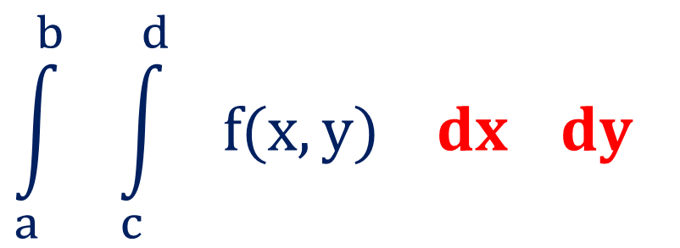
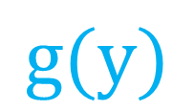
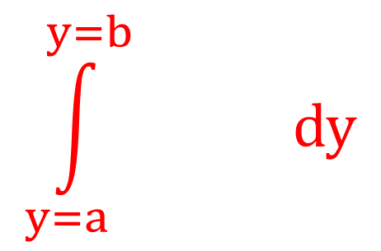
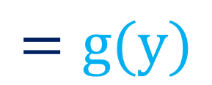
Double Integral with Constant Limit
$$\int_{a}^{b}{ \int_{c}^{d}{ f(x, y) dx }dy }$$
$$\int_{x=c}^{x=d}{ f(x, y) dx}$$
$$\int_{y=a}^{y=b}{ dy}$$
$$g(y)$$
$$=g(y)$$
$$=$$

Slide 13
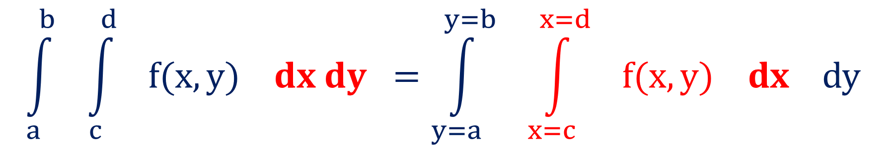
Double Integral with Constant Limit
$$\int_{a}^{b}{ \int_{c}^{d}{ f(x, y) dx dy}} =\int_{y=a}^{y=b}{ \int_{x=c}^{x=d}{ f(x, y) dx dy}}$$

Slide 14
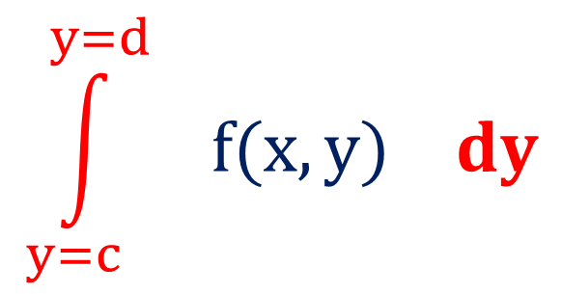
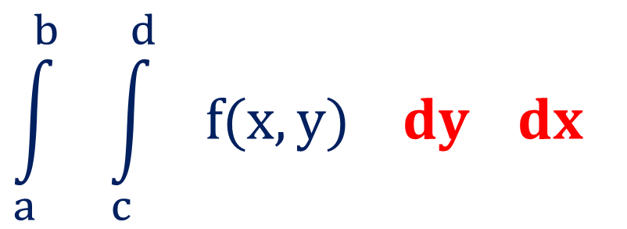
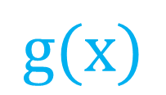
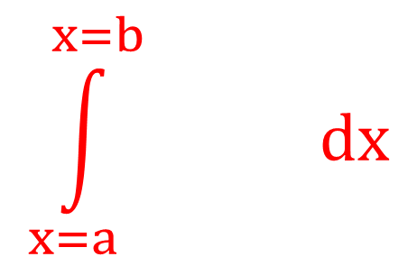
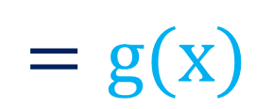
Double Integral with Constant Limit
$$\int_{a}^{b}{ \int_{c}^{d}{ f(x, y) dy }dx }$$
$$\int_{y=c}^{y=d}{ f(x, y) dy}$$
$$\int_{x=a}^{x=b}{ dx}$$
$$g(x)$$
$$=g(x)$$
$$=$$

Slide 15
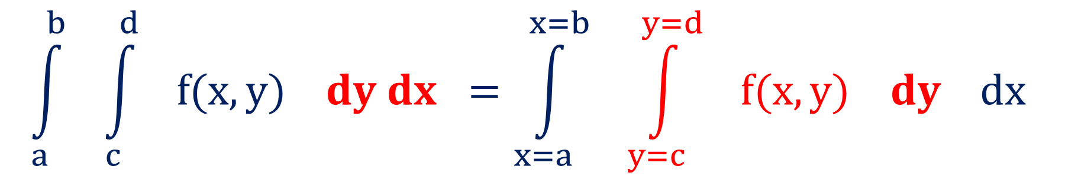
Double Integral with Constant Limit
$$\int_{a}^{b}{ \int_{c}^{d}{ f(x, y) dy dx}} =\int_{x=a}^{x=b}{ \int_{y=c}^{y=d}{ f(x, y) dy dx}}$$

Slide 16
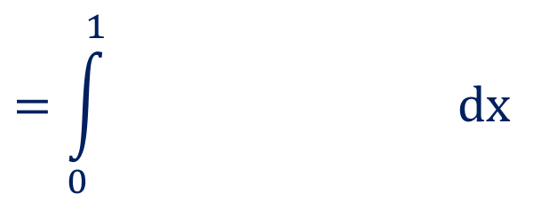
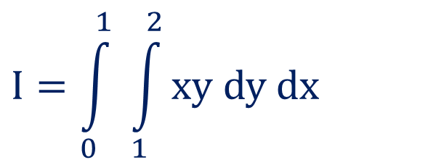
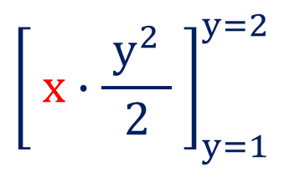

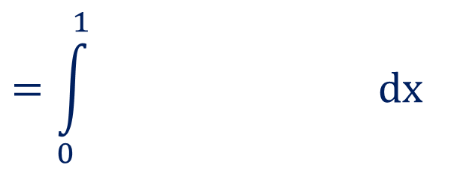


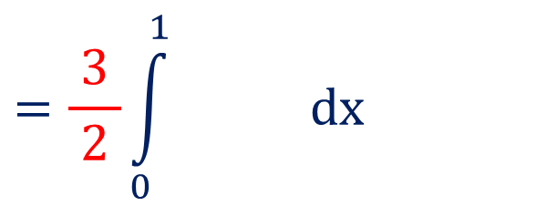
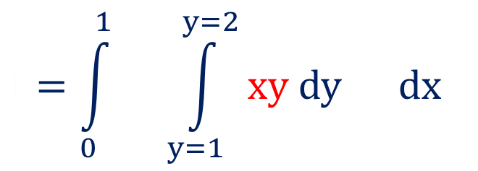
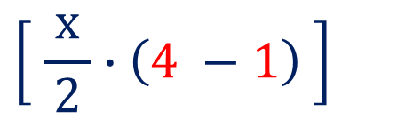
Method 1 $⇒$ Example – 3
$$=\int_{0}^{1}{ dx}$$
$$Evaluate \int_{0}^{1}{ \int_{1}^{2}{xy dy dx}.}$$
$${\left[ x∙\frac{{ y}^{2} }{2} \right]}_{y=1}^{y=2}$$
$$=\int_{0}^{1}{ dx}$$
Solution: W-19 (3 marks)
$$\left[ \frac{ x }{2}∙\left(4 −1\right) \right]$$
$$I=\int_{0}^{1}{ \int_{1}^{2}{xy dy dx}}$$
$$=\frac{3}{ 2 }\int_{0}^{1}{ dx}$$
……
$$\left[ x \right]$$
$$I=\int_{0}^{1}{ \int_{y=1}^{y=2}{xy dy dx}}$$
$$I = \frac{3}{ 4 }$$

Slide 17
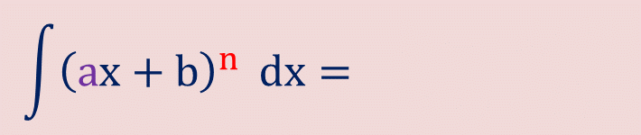

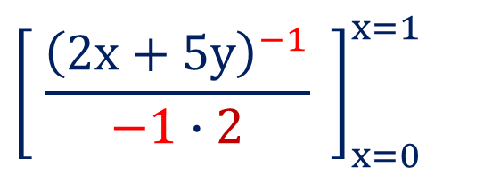
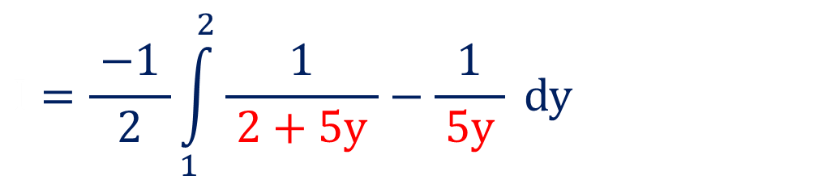
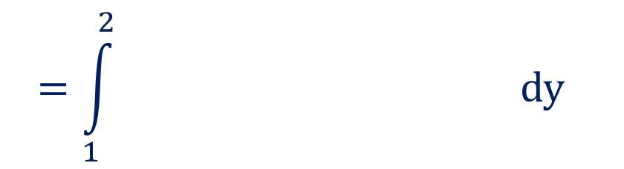

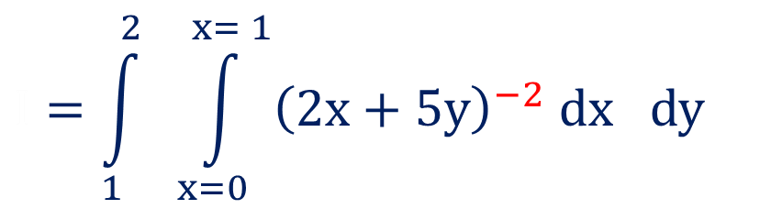
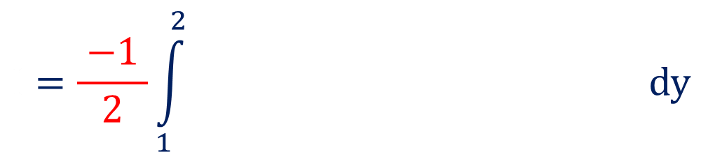
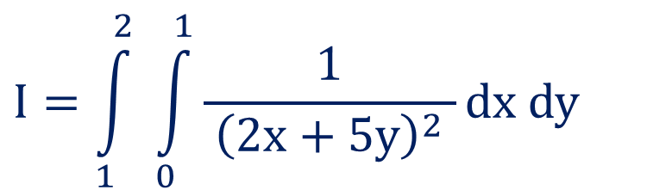
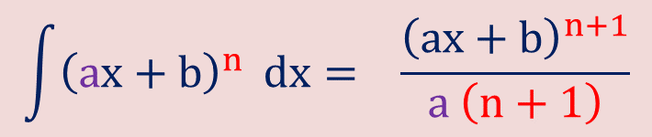
Method 1 $⇒$ Example – 5
$$Evaluate\int_{1}^{2}{ \int_{0}^{1}{\frac{1}{ {\left(2x+5y\right)}^{2} }dx dy}.}$$
$$I=\int_{1}^{2}{ }dy$$
$${\left[ \frac{{\left(2x+5y\right)}^{−1}}{−1∙2} \right]}_{x=0}^{x=1}$$
Solution:
$$I=\frac{ −1 }{2}\int_{1}^{2}{ }dy$$
$${\left(2+5y\right)}^{−1}−{\left(0+5y\right)}^{−1}$$
$$I=\int_{1}^{2}{ \int_{0}^{1}{\frac{1}{ {\left(2x+5y\right)}^{2} }dx dy}}$$
$$I=\frac{ −1 }{2}\int_{1}^{2}{\frac{1}{ 2+5y }−\frac{1}{ 5y }} dy$$
$$I=\int_{1}^{2}{ \int_{x=0}^{x= 1}{{\left(2x+5y\right)}^{−2} dx dy}}$$
$$\int{{\left(ax+b\right)}^{n}} dx= \frac{{\left(ax+b\right)}^{n+1}}{a \left(n+1\right)}$$
$$\int{{\left(ax+b\right)}^{n}} dx= \frac{{\left(ax+b\right)}^{n+1}}{a \left(n+1\right)}$$

Slide 18
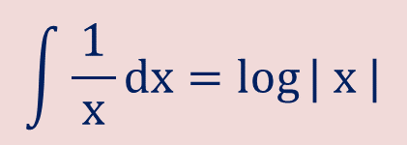
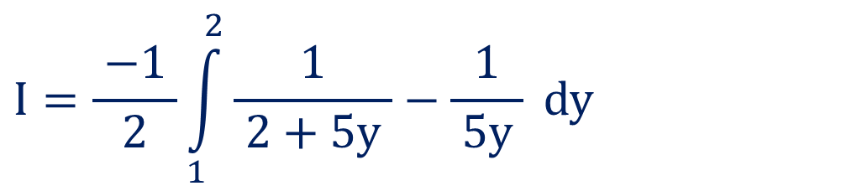
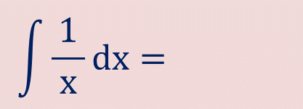

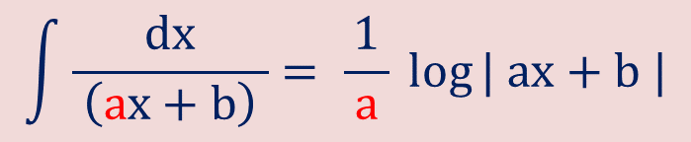
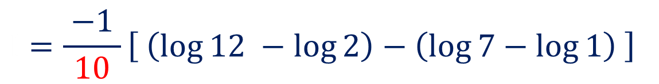
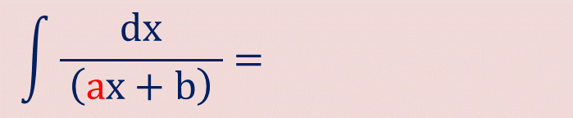
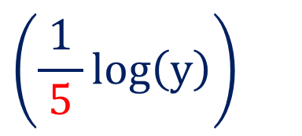
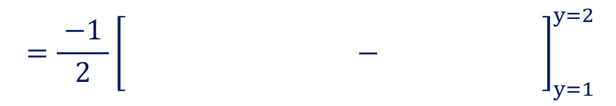
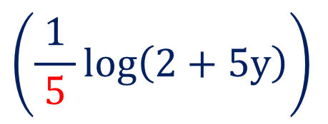
Method 1 $⇒$ Example – 5(continue)
$$I=\frac{ −1 }{2}\int_{1}^{2}{\frac{1}{ 2+5y }−\frac{1}{ 5y }} dy$$
$$I=\frac{ −1 }{2}{\left[ \left(\frac{1}{ 5 }\log\left(2+5y\right)\right)−\left(\frac{1}{ 5 }\log\left(y\right)\right) \right]}_{y=1}^{y=2}$$
$$\left(\frac{1}{ 5 }\log\left(2+5y\right)\right)$$
$$\left(\frac{1}{ 5 }\log\left(y\right)\right)$$
$$I=\frac{ −1 }{10}\left[ \left(\log{12} −\log{2}\right)−\left(\log{7}−\log{1}\right) \right]$$
$$I=0.1 \left[ −\log{12}+\log{2}+\log{7} \right]$$
$$\int{\frac{1}{ x }dx=\log{| x |}}$$
$$\int{\frac{1}{ x }dx=\log{| x |}}$$
$$\int{\frac{dx}{ \left(ax+b\right) }= \frac{1}{ a }\log{| ax+b |}}$$
$$\int{\frac{dx}{ \left(ax+b\right) }= \frac{1}{ a }\log{| ax+b |}}$$

Slide 19
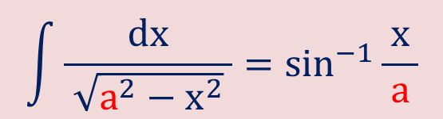

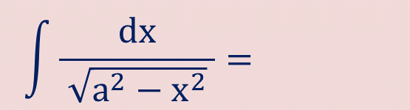
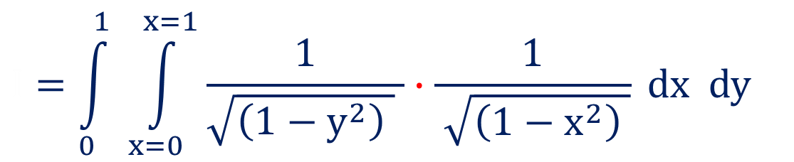
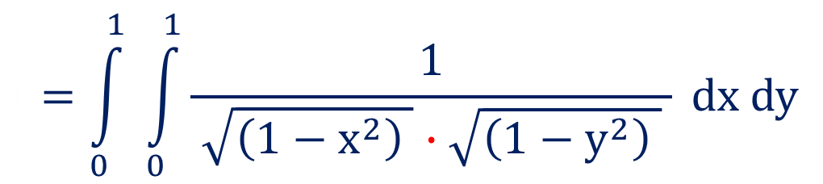
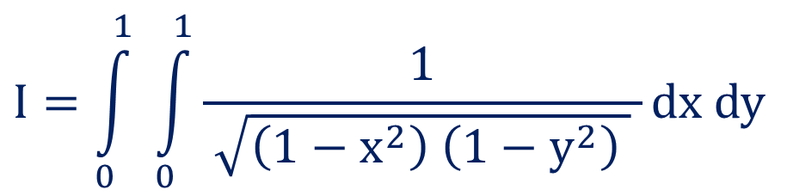
Method 1 $⇒$ Example – 6
$$Evaluate \int_{0}^{1}{ \int_{0}^{1}{\frac{1}{ \sqrt{\left(1−x^{2}\right)\left(1−y^{2}\right) }}}}dx dy.$$
Solution:
$$I=\int_{0}^{1}{ \int_{0}^{1}{\frac{1}{ \sqrt{\left(1−x^{2}\right) \left(1−y^{2}\right) } }}}dx dy$$
$$I=\int_{0}^{1}{ \int_{0}^{1}{\frac{1}{ \sqrt{\left(1−x^{2}\right) }∙\sqrt{\left(1−y^{2}\right) } }}} dx dy$$
$$I=\int_{0}^{1}{ \int_{x=0}^{x=1}{\frac{1}{\sqrt{\left(1−y^{2}\right) } }∙\frac{1}{ \sqrt{\left(1−x^{2}\right) }}} }dx dy$$
$$\int{\frac{dx}{ \sqrt{a^{2}−x^{2}} }=\sin^{−1}{\frac{ x }{a}}}$$
$$\int{\frac{dx}{ \sqrt{a^{2}−x^{2}} }=\sin^{−1}{\frac{ x }{a}}}$$

Slide 20
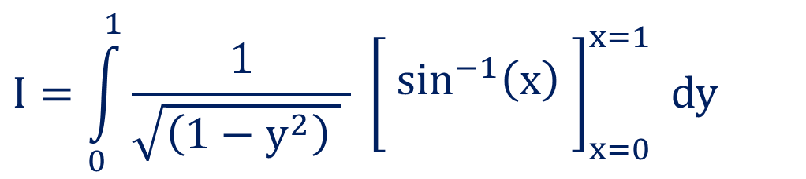



Method 1 $⇒$ Example – 6(continue)
$$I=\int_{0}^{1}{\frac{1}{\sqrt{\left(1−y^{2}\right) } } }{\left[ \begin{matrix} \\ \sin^{−1}\left(x\right) \\ \end{matrix}\right]}_{x=0}^{x=1} dy$$
$$I =\frac{ π^{2} }{ 4 }$$
$$I=\int_{0}^{1}{\frac{1}{\sqrt{\left(1−y^{2}\right) } } }\left[ \frac{π}{ 2 }−0 \right]dy$$
$$I=\frac{π}{ 2 }\int_{0}^{1}{\frac{1}{\sqrt{\left(1−y^{2}\right) } } }dy$$
……

Slide 21









Method 1 $⇒$ Example – 8
$$Evaluate\int_{1}^{4}{ \int_{2x^{2}}^{{3x}^{2}}{\left(x e^{x^{2}+y}\right) dy dx}}.$$
$$I=\int_{1}^{4}{x∙e^{x^{2}} {\left[\begin{matrix} \\ e^{y} \\ \end{matrix}\right]}_{y=2x^{2}}^{y=3x^{2}} dx}$$
$${\left[\begin{matrix} \\ e^{y} \\ \end{matrix}\right]}_{y=2x^{2}}^{y=3x^{2}}$$
Solution:
$$I=\int_{1}^{4}{x∙e^{x^{2}}\left( e^{3x^{2}}−e^{2x^{2}} \right) dx}$$
$$I=\int_{1}^{4}{ \int_{2x^{2}}^{{3x}^{2}}{\left(x e^{x^{2}+y}\right) dy dx}}$$
$$I=\int_{1}^{4}{\left(x∙e^{{4x}^{2}}−x∙e^{{3x}^{2}}\right) dx}$$
$$I=\int_{1}^{4}{ \int_{y=2x^{2}}^{{y=3x}^{2}}{\left( x∙e^{x^{2}}∙e^{y} \right) dy dx}}$$
$$\int{f^{′}\left(x\right) e^{f\left(x\right)}} dx=e^{f\left(x\right)}$$
$$\int{f^{′}\left(x\right) e^{f\left(x\right)}} dx=e^{f\left(x\right)}$$

Slide 22





Method 1 $⇒$ Example – 8(continue)
$$I=\int_{1}^{4}{\left(\frac{8 x}{8}∙e^{{4x}^{2}}−\frac{6 x}{6}∙e^{{3x}^{2}}\right)dx}$$
$$I={\left[ \frac{{ e}^{{4x}^{2}} }{8}−\frac{{ e}^{{3x}^{2}} }{6} \right]}_{x=1}^{x=4}$$
$$\frac{{ e}^{{4x}^{2}} }{8}$$
$$\frac{{ e}^{{3x}^{2}} }{6}$$
……
$$I =\frac{{ e}^{64}−{ e}^{4} }{8} − \frac{ e^{48}−e^{3} }{6}$$

Slide 23








Method 1 $⇒$ Example – 13
$$Evaluate\int_{0}^{\frac{π}{ 2 }}{ }\int_{0}^{1−\sin{θ}}{r^{2}}\cos{θ} dr dθ.$$
$$I=\int_{0}^{\frac{π}{ 2 }}{\cos{θ}}{\left[\frac{{ r}^{3 }}{3}\right]}_{r=0}^{r=1−\sin{θ}}dθ$$
$${\left[\frac{{ r}^{3 }}{3}\right]}_{r=0}^{r=1−\sin{θ}}$$
$$I=\frac{1}{ 3 }\int_{0}^{\frac{π}{ 2 }}{\cos{θ}}\left[ {\left(1−\sin{θ}\right)}^{3} \right] dθ$$
Solution:
$$I=\int_{0}^{\frac{π}{ 2 }}{ }\int_{0}^{1−\sin{θ}}{r^{2}}\cos{θ} dr dθ$$
$$I=\frac{−1}{ 3 }\int_{0}^{\frac{π}{ 2 }}{(−cos{θ}}) {\left(1−\sin{θ}\right)}^{3} dθ$$
$$I=\int_{0}^{\frac{π}{ 2 }}{ }\int_{r=0}^{r=1−\sin{θ}}{r^{2}}\cos{θ} dr dθ$$
$$\int{{{\left[f\left(x\right)\right]}^{ }}^{n} f^{′}\left(x\right) dx=\frac{{ {\left[f\left(x\right)\right]}^{ }}^{n+1}}{n+1}, n≠−1}$$

Slide 24



Method 1 $⇒$ Example – 13(continue)
$$I=\frac{−1}{ 3 }\int_{0}^{\frac{π}{ 2 }}{(−cos{θ}}) {\left(1−\sin{θ}\right)}^{3} dθ$$
$$I=\frac{−1}{ 3 }{\left[ \frac{{ \left(1−\sin{θ}\right)}^{4} }{4} \right]}_{θ=0}^{θ= \frac{ π }{2}}$$
……
$$I =\frac{1}{12}$$

Slide 25
Triple Integrals By Direct Integration

Slide 26

What is Triple Integral?
Integrals of a function of three variables over a region in $ℝ^{3}$ are called triple integrals.
For example:
Double Integral of a function of three variables f(x, y, z) over region R in $ℝ^{3}$ is
$$\iiint_{R}^{ }{f(x, y,z)}dV = \iiint_{R}^{ }{f(x, y,z)}dx dy dz = \iiint_{R}^{ }{f(x, y,z)}dy dx dz =…$$

Slide 27





Triple Integral with Constant Limit
$$\int_{a}^{b}{\int_{c}^{d}{ dy dx}}$$
$$\int_{z=m}^{z=n}{f(x, y,z)} dz$$
$$\int_{a}^{b}{\int_{c}^{d}{ \int_{m}^{n}{f(x, y,z)}dz dy dx}}$$
$$=g(x,y)$$
$$g(x,y)$$
$$=$$

Slide 28





Triple Integral with Constant Limit
$$\int_{a}^{b}{\int_{c}^{d}{ dz dy}}$$
$$\int_{x=m}^{x=n}{f(x, y,z)} dx$$
$$\int_{a}^{b}{\int_{c}^{d}{ \int_{m}^{n}{f(x, y,z)}dx dz dy}}$$
$$=g(y,z)$$
$$g(y,z)$$
$$=$$

Slide 29



Triple Integral with Constant Limit
$$\int_{a}^{b}{\int_{c}^{d}{\int_{m}^{n}{f(x, y,z)}dx dy dz}} =\int_{z=a}^{z=b}{ \int_{y=c}^{y=d}{ \int_{x=m}^{x=n}{f(x, y,z)} dx dy dz}}$$
$$=\int_{z=a}^{z=b}{ \int_{y=c}^{y=d}{ g\left(y,z\right) dy dz}}$$
$$=\int_{z=a}^{z=b}{h\left(z\right)} dz$$

Slide 30



Triple Integral with Constant Limit
$$\int_{a}^{b}{\int_{c}^{d}{\int_{m}^{n}{f(x, y,z)}dz dx dy}} =\int_{y=a}^{y=b}{ \int_{x=c}^{x=d}{ \int_{z=m}^{z=n}{f(x, y,z)} dz dx dy}}$$
$$=\int_{y=a}^{y=b}{ \int_{x=c}^{x=d}{ g\left(x,y\right) dx dy}}$$
$$=\int_{y=a}^{y=b}{h\left(y\right)} dy$$

Slide 31








Method 2 $⇒$ Example – 2
$$Evaluate\int_{−1}^{1}{ \int_{0}^{2}{ \int_{0}^{1}{xz−y^{3} dz dy dx.}}}$$
$$I=\int_{−1}^{1}{ \int_{0}^{2}{ }{\left[ x\frac{{ z}^{2} }{2}−y^{3} z \right]}_{z=0}^{z=1} dy dx}$$
$${\left[ x\frac{{ z}^{2} }{2}−y^{3} z \right]}_{z=0}^{z=1}$$
Solution:
$$I=\int_{−1}^{1}{ \int_{0}^{2}{ \left[ \left(\frac{ x }{2}−y^{3}\right)−\left(0\right) \right]} dy dx}$$
$$\left[ \left(\frac{ x }{2}−y^{3}\right)−\left(0\right) \right]$$
$$I=\int_{−1}^{1}{ \int_{0}^{2}{ \int_{0}^{1}{xz−y^{3} dz dy dx}}}$$
$$I=\int_{−1}^{1}{ \int_{0}^{2}{\frac{ x }{2}−y^{3}} dy dx}$$
$$I=\int_{−1}^{1}{ \int_{0}^{2}{ \int_{0}^{1}{xz−y^{3} dz dy dx}}}$$

Slide 32






Method 2 $⇒$ Example – 2(continue)
$$I=\int_{−1}^{1}{ \int_{0}^{2}{\frac{ x }{2}−y^{3}} dy dx}$$
$$I=\int_{−1}^{1}{ \left[ x−4 \right] dx}$$
$$I=\int_{−1}^{1}{ {\left[ \frac{ x }{2}y−\frac{{ y}^{4} }{4} \right]}_{y=0}^{y=2} dx}$$
$${\left[ \frac{ x }{2}y−\frac{{ y}^{4} }{4} \right]}_{y=0}^{y=2}$$
……
$$I=\int_{−1}^{1}{ \left[ \left(x−4\right) −(0) \right] dx}$$
$$I =−8$$

Slide 33









Method 2 $⇒$ Example – 3
$$Evaluate\int_{0}^{1}{ \int_{0}^{1−x}{ \int_{0}^{1−x−y}{z}}} dz dy dx.$$
$$I=\frac{1}{ 2 }\int_{0}^{1}{ \int_{0}^{1−x}{{\left(1−x−y\right)}^{2}}} dy dx$$
Solution:
$$I=\frac{1}{ 2 }\int_{0}^{1}{{\left[ \frac{{\left(1−x−y\right)}^{3}}{3} \right]}_{y=0}^{y=1−x}}dx$$
$${\left[ \frac{{\left(1−x−y\right)}^{3}}{3 } \right]}_{y=0}^{y=1−x}$$
$$I=\int_{0}^{1}{ \int_{0}^{1−x}{ \int_{0}^{1−x−y}{z}}} dz dy dx$$
$$∙\left(−1\right)$$
$$I=\frac{−1}{ 6 }\int_{0}^{1}{\left[ \left(0\right)−{\left(1−x\right)}^{3} \right]}dx$$
$$I=\int_{0}^{1}{ \int_{0}^{1−x}{ {\left[\frac{ z^{2} }{2}\right]}_{z=0}^{z=1−x−y}}} dz dy dx$$
$${\left[\frac{ z^{2} }{2}\right]}_{z=0}^{z=1−x−y}$$
$$\int{{\left(ax+b\right)}^{n}} dx= \frac{{\left(ax+b\right)}^{n+1}}{a \left(n+1\right)}$$

Slide 34



Method 2 $⇒$ Example – 3(continue)
$$I=\frac{−1}{ 6 }\int_{0}^{1}{\left[ −{\left(1−x\right)}^{3} \right]}dx$$
$$I=\frac{+1}{ 6 }\int_{0}^{1}{{ \left(1−x\right)}^{3}} dx$$
……
$$I =\frac{1}{ 24 }$$

Slide 35






Integration by Parts
L = Logarithmic functions
I = Inverse functions
A = Arithmetic functions
T = Trigonometric functions
E = Exponential function
$$\int{\left(u∗v\right) dx=}$$
$$\int{v dx}$$
$$u ∗$$
$$−\int{\left\{ \frac{du}{dx} ∗\int{v} dx \right\}}dx$$
$$\int{v} dx$$
$$\frac{du}{dx}$$
Here u & v both are functions of variable x

Slide 36



Method 2 $⇒$ Example – 12
$$Evaluate\int_{0}^{\log{2}}{ \int_{0}^{x}{ \int_{0}^{x+\log{y}}{e^{x+y+z} }}}dz dy dx.$$
Solution:
$$I=\int_{0}^{\log{2}}{ \int_{0}^{x}{ \int_{0}^{x+\log{y}}{e^{x+y+z} }}}dz dy dx$$
$$I=\int_{0}^{\log{2}}{\int_{0}^{x}{ \int_{0}^{x+\log{y}}{e^{x} e^{y} e^{z}}}}dz dy dx$$

Slide 37






Method 2 $⇒$ Example – 12(continue)
$$I=\int_{0}^{\log{2}}{\int_{0}^{x}{ }e^{x} e^{y} {\left[ e^{z} \right]}_{z=0}^{z=x+\log{y}}} dy dx$$
$${\left[ e^{z} \right]}_{z=0}^{z=x+\log{y}}$$
$$I=\int_{0}^{\log{2}}{\int_{0}^{x}{ }e^{x} e^{y}\left[ e^{x+\log{y}}−e^{0}\right]} dy dx$$
$$I=\int_{0}^{\log{2}}{\int_{0}^{x}{ }e^{x} e^{y}\left[ e^{x}e^{\log{y}}−1\right]} dy dx$$
$$I=\int_{0}^{\log{2}}{\int_{0}^{x}{ }e^{x} e^{y}\left[ e^{x} y−1\right]} dy dx$$
$$=\int_{0}^{\log{2}}{\int_{0}^{x}{ }}\left[ e^{2x} e^{y} y −e^{x} e^{y} \right] dy dx$$

Slide 38










Method 2 $⇒$ Example – 12(continue)
$$I=\int_{0}^{\log{2}}{\int_{0}^{x}{ }}\left[ e^{2x} e^{y} y −e^{x} e^{y} \right] dy dx$$
$$\int{y e^{y} dy}$$
$$I=\int_{0}^{\log{2}}{\left\{ {e^{2x }\left[\begin{matrix} \\ y e^{y}−e^{y} \\ \end{matrix}\right]}_{y=0}^{y=x}−{e^{x} \left[\begin{matrix} \\ e^{y} \\ \end{matrix}\right]}_{y=0}^{y=x} \right\}} dx$$
$${\left[\begin{matrix} \\ y e^{y}−e^{y} \\ \end{matrix}\right]}_{y=0}^{y=x}$$
$${\left[\begin{matrix} \\ e^{y} \\ \end{matrix}\right]}_{y=0}^{y=x}$$
$$=y\int{ e^{y} dy}−\int{\left[ \frac{dy}{dy}\int{e^{y} dy} \right]dy}$$
$$I=\int_{0}^{\log{2}}{\left\{\begin{aligned} \\ \begin{aligned}\begin{aligned} \\ e^{2x }\left[ \left(x e^{x}−e^{x}\right)−\left(0−e^{0}\right) \right] \end{aligned} \\ \\ − e^{x }\left[ \left(e^{x}−e^{0}\right) \right]\end{aligned} \\ \end{aligned}\right\}dx }$$
$$\left[ \left(x e^{x}−e^{x}\right)−\left(0−e^{0}\right) \right]$$
$$\left[ \left(e^{x}−e^{0}\right) \right]$$
$$=y{ e}^{y}−e^{y}$$

Slide 39






Method 2 $⇒$ Example – 12(continue)
$$I=\int_{0}^{\log{2}}{\left\{\begin{aligned} \\ \begin{aligned} \\ e^{2x }\left[ \left(x e^{x}−e^{x}\right)−\left(0−e^{0}\right) \right]− e^{x }\left[ \left(e^{x}−e^{0}\right) \right] \\ \end{aligned} \\ \end{aligned}\right\}dx }$$
$$I=\int_{0}^{\log{2}}{\left\{\begin{aligned} \\ \begin{aligned} \\ \left[ \left(x e^{3x}−e^{3x}\right)+\left(e^{2x}\right) \right]−\left[ \left(e^{2x}−e^{1x}\right) \right] \\ \end{aligned} \\ \end{aligned}\right\}dx }$$
$$I=\int_{0}^{\log{2}}{\left\{\begin{aligned} \\ \begin{aligned} \\ x e^{3x}−e^{3x}+e^{x} \\ \end{aligned} \\ \end{aligned}\right\}dx }$$
……
$$\log\left(x^{y}\right)=y\log{x}$$
$$I =\frac{ 8 log 2 }{3}−\frac{19}{9}$$
$$e^{ y\log{x} }=e^{ \log\left(x^{y}\right) }$$
$$e^{ y\log{x} }=\left(x^{y}\right)$$

Slide 40







Method 2 $⇒$ Example – 15
$$Evaluate\int_{1}^{e}{ \int_{1}^{\log{y}}{ \int_{1}^{e^{x}}{(x^{2}+y^{2})} dz dx dy}}.$$
$$I=\int_{1}^{e}{ \int_{1}^{\log{y}}{\left(x^{2}+y^{2}\right) \left[e^{x}−1\right] dx dy}}$$
Solution: W-18(4 Mark)
$$I=\int_{1}^{e}{ \int_{1}^{\log{y}}{\left[ \begin{aligned}x^{2}\left(e^{x}−1\right) \\ + \\ y^{2}\left(e^{x}−1\right)\end{aligned} \right] dx dy}}$$
$$I=\int_{1}^{e}{ \int_{1}^{\log{y}}{ \int_{1}^{e^{x}}{(x^{2}+y^{2})} dz dx dy}}$$
$$I=\int_{1}^{e}{ \int_{1}^{\log{y}}{\left(x^{2}+y^{2}\right) {\left[z\right]}_{z=1}^{z=e^{x}} dx dy}}$$
$${\left[z\right]}_{z=1}^{z=e^{x}}$$
$$\int{u∙v dx=u\int{v dx−\int{\left\{ \frac{du}{ dx }∗\int{v} dx \right\}}dx}}$$

Slide 41









Method 2 $⇒$ Example – 15(continue)
$$I=\int_{1}^{e}{ \int_{1}^{\log{y}}{\left[ x^{2}\left(e^{x}\right)−x^{2}+y^{2}\left(e^{x}−1\right) \right] dx dy}}$$
$$\int{x^{2} e^{x} dx}$$
$$I=\int_{1}^{e}{ \left\{\begin{aligned}{\left[ x^{2} e^{x}−2 x e^{x}+2 e^{x} \right]}_{x=1}^{x=\log{y}} \\ \\ −{\left[\frac{ x^{3} }{3}\right]}_{x=1}^{x=\log{y}}+{y^{2}\left[ e^{x}−x \right]}_{x=1}^{x=\log{y}}\end{aligned}\right\} }dy$$
$$=x^{2} e^{x}−\int{\left[2x ∙ e^{x}\right]dx}$$
$${\left[ x^{2} e^{x}−2 x e^{x}+2 e^{x} \right]}_{x=1}^{x=\log{y}}$$
$${\left[\frac{ x^{3} }{3}\right]}_{x=1}^{x=\log{y}}$$
$$=x^{2} e^{x}−$$
$$\left[2x ∙ e^{x}−\int{\left[2 ∙ e^{x}\right]dx}\right]$$
$${\left[ e^{x}−x \right]}_{x=1}^{x=\log{y}}$$
$$=x^{2} e^{x}−2 x e^{x}+2 e^{x}$$

Slide 42







Method 2 $⇒$ Example – 15(continue)
$$I=\int_{1}^{e}{ {\left\{ x^{2} e^{x}−2 x e^{x}+2 e^{x} −\frac{ x^{3} }{3}+y^{2}\left[ e^{x}−x \right] \right\}}_{x=1}^{x=\log{y}}}dy$$
$$=\int_{1}^{e}{ \left[\left\{\begin{aligned}{\left(\log{y}\right)}^{2} e^{\log{y}}−2\log{y}e^{\log{y}}+2 e^{\log{y}} \\ −\frac{ {\left(\log{y}\right)}^{3} }{3}+y^{2}\left[ e^{\log{y}}−\log{y}\right]\end{aligned}\right\}−\left\{\begin{aligned}{\left(1\right)}^{2} e^{1}−2 1 e^{1}+2 e^{1} \\ −\frac{ {\left(1\right)}^{3} }{3}+y^{2}\left[ e^{1}−1\right]\end{aligned}\right\}\right]}dy$$
$$\begin{aligned}{\left(\log{y}\right)}^{2} e^{\log{y}}−2\log{y}e^{\log{y}}+2 e^{\log{y}} \\ −\frac{ {\left(\log{y}\right)}^{3} }{3}+y^{2}\left[ e^{\log{y}}−\log{y} \right]\end{aligned}$$
$$\begin{aligned}{\left(1\right)}^{2} e^{1}−2 1 e^{1}+2 e^{1} \\ −\frac{ {\left(1\right)}^{3} }{3}+y^{2}\left[ e^{1}−1\right]\end{aligned}$$
$$=\int_{1}^{e}{ \left[ \left\{ \begin{aligned}{\left(\log{y}\right)}^{2} y−2\log{y}∙y+2y \\ −\frac{ {\left(\log{y}\right)}^{3} }{3}+y^{2}\left[ y−\log{y} \right]\end{aligned} \right\}−\left\{ e−2 e+2 e −\frac{ 1 }{3}+y^{2}\left[ e−1\right] \right\} \right]}dy$$
$$\begin{aligned}{\left(\log{y}\right)}^{2} y−2\log{y}∙y+2y \\ −\frac{ {\left(\log{y}\right)}^{3} }{3}+y^{2}\left[ y−\log{y} \right]\end{aligned}$$
$$e−2 e+2 e −\frac{ 1 }{3}+y^{2}\left[ e−1\right]$$

Slide 43











Method 2 $⇒$ Example – 15(continue)
$$I=\int_{1}^{e}{ \left[ \left\{ \begin{aligned}{\left(\log{y}\right)}^{2} y−2\log{y}∙y+2y \\ −\frac{ {\left(\log{y}\right)}^{3} }{3}+y^{2}\left[ y−\log{y} \right]\end{aligned} \right\}−\left\{ e−\frac{ 1 }{3}+y^{2}\left[ e−1\right] \right\} \right]}dy$$
$$=\int_{1}^{e}{ \left[y\log^{2}{y}−2 y\log{y}−y^{2}\log{y}−\frac{ \log^{3}{y} }{3}+{ y}^{3}+y^{2}−ey^{2}+2y−e+\frac{ 1 }{3}\right]}dy$$
$$\frac{e^{2}}{4}−\frac{1}{4}$$
$$\frac{e^{2}}{2}+\frac{1}{2}$$
$$\frac{{2e}^{3}}{9}+\frac{1}{9}$$
$$2−\frac{2e}{3}$$
$$\frac{{−e}^{4}}{12}+\frac{e^{3}}{3}+\frac{5e}{3}−\frac{23}{12}$$
……
$$−$$
$$−$$
$$−$$
$$+$$
$$I =(−3e^{4}+4e^{3}−9e^{2}+84e−172)/36$$

Slide 44





Method 2 $⇒$ Example – 16
$$Evaluate \iiint_{v}^{ }{dv}\text{, }\text{where} \text{v} \text{is} \text{the} \text{solid} \text{region} \text{bounded} \text{by}$$
$$1≤x≤2, 2≤y≤4 \& 2≤z≤5\text{.}$$
Solution:
$$I=\iiint_{v}^{ }{1 dv}$$
$$I=\int_{z=2}^{5}{ \int_{y=2}^{4}{ \int_{x=1}^{2}{ 1}}} dx dy dz$$
$$\int{ 1} dx dy dz$$
……
$$I =6$$

Slide 45



Method 2 $⇒$ Example – 17
$$Evaluate\int_{0}^{1}{ \int_{0}^{\sqrt{z }}{ \int_{0}^{2π}{\left(r^{2}\cos^{2}θ {+ z}^{2}\right) r dθ dr dz}}}.$$
Solution:
$$I=\int_{0}^{1}{ \int_{0}^{\sqrt{z }}{ \int_{0}^{2π}{\left(r^{2}\cos^{2}θ {+ z}^{2}\right) r dθ dr dz}}}$$
$$I=\int_{0}^{1}{ \int_{0}^{\sqrt{z }}{ \int_{0}^{2π}{\left(r^{3}\cos^{2}θ {+r z}^{2}\right) dθ dr dz}}}$$

Slide 46







Method 2 $⇒$ Example – 17(continue)
$$I=\int_{0}^{1}{ \int_{0}^{\sqrt{z }}{ \int_{0}^{2π}{\left(r^{3} \left\{\frac{1}{ 2 }−\frac{\cos{2θ }}{2}\right\} {+r z}^{2}\right) dθ dr dz}}}$$
$$\frac{1}{ 2 }+\frac{\cos{2θ }}{2}$$
$$I=\int_{0}^{1}{ \int_{0}^{\sqrt{z }}{{\left[ r^{3} \left\{ \frac{θ}{ 2 }+\frac{\sin{2θ }}{2} \right\} {+ r z}^{2}θ\right]}_{θ=0}^{θ=2π}dr dz}}$$
$$\frac{θ}{ 2 }+\frac{\sin{2θ }}{4}$$
$$θ$$
$$I=\int_{0}^{1}{ \int_{0}^{\sqrt{z }}{\left[ r^{3} \left\{ π \right\} {+ r z}^{2}\left\{ 2π \right\} \right] dr dz}}$$
……
$$I =\frac{π}{ 3 }$$

Slide 47

Method 2 $⇒$ Example – 18
$$Evaluate\int_{0}^{\frac{π}{ 2 }}{ \int_{0}^{\frac{π}{ 2 }}{ \int_{0}^{a}{ r^{7}\sin^{3}{θ}\cos{θ}\sin{ϕ cosϕ} dr dθ dϕ}}}\text{.}$$
Solution:
How to Write answer in Exam?

Slide 48


Method 2 $⇒$ Example – 18(continue)

Slide 49
Double Integrals Over General Region - CC
Strip parallel to X-axis
Strip parallel to Y-axis
Division of the Region

Slide 50
Procedure to find double integral over General Region - CC
If we want to find the value of given double integral over general region in CC, we will follow following steps:
Draw all the curves and identify required region.
Find the point(s) of intersection of all the curves if required.
Take the strip parallel to x-axis or y-axis.
If required then divide the region into two parts.
Find limits of inner integral from the strip.
Find limits of outer integral from axis.
Calculate the example as the example of double integrals.

Slide 51



Strip parallel to X-axis – Limit of Inner Integral
If we take a strip parallel to X-axis then
Curve at starting point P of strip gives lower limit of inner integral i.e. x = g(y).
Curve at end point Q of strip gives upper limit of inner integral i.e. x = h(y).

Slide 52

Strip parallel to X-axis – Limit of outer Integral
If we take a strip parallel to X-axis then
Lower limit of outer integral is starting point of region on Y-axis i.e. y = c.
Upper limit of outer integral is end point of region on Y-axis i.e. y = d.

Slide 53


Strip parallel to X-axis
So if we take a strip parallel to X-axis then
we have to integrate given function
first with respect to variable x and
then variable y.
$$\iint_{R}^{ }{f\left(x,y\right) dA}=$$
$$\int_{y=c}^{y=d}{ \left\{\int_{ x=g(y)}^{x=h(y)}{f\left(x,y\right) dx }\right\}} dy$$

Slide 54



Strip parallel to Y-axis – Limit of Inner Integral
If we take a strip parallel to Y-axis then
Curve at starting point P of strip gives lower limit of inner integral i.e. y = g(x).
Curve at end point Q of strip gives upper limit of inner integral i.e. y = h(x).

Slide 55

Strip parallel to Y-axis – Limit of outer Integral
If we take a strip parallel to Y-axis then
Lower limit of outer integral is starting point of region on X-axis i.e. x = a.
Upper limit of outer integral is end point of region on X-axis i.e. x = b.

Slide 56


Strip parallel to Y-axis
So if we take a strip parallel to Y-axis then
we have to integrate given function
first with respect to variable y and
then variable x.
$$\iint_{R}^{ }{f\left(x,y\right) dA}=$$
$$\int_{x=a}^{x=b}{ \left\{\int_{ y=g(x)}^{y=h(x)}{f\left(x,y\right) dy }\right\}} dx$$

Slide 57








Division of the Region
If end points of taken strip change the curve in given region then we have to split the region into more than one part.
After splitting we have to evaluate given integral for each sub region.

Slide 58



Division of the Region
If end points of taken strip change the curve in given region then we have to split the region into more than one part.
After splitting we have to evaluate given integral for each sub region.

Slide 59








Method 3 $⇒$ Example – 5
$$Evaluate \iint_{R}^{ }{e^{2x+3y} dx dy,}$$
$$where R is the triangle bounded$$
$by$ $x=0, y=0, x+y=1$.
Draw all the curves and identify required region.
Find the point(s) of intersection of all the curves if required.
Take the strip parallel to x-axis or y-axis.
If required then divide the region into two parts.
Find limits of inner integral from the strip.
Find limits of outer integral from axis.
Calculate the example as the example of double integrals.
x = 0
x + y = 1
Solution:
$$\iint_{R}^{ }{e^{2x+3y}}dx dy=$$
$$\int_{y=0}^{1}{ \int_{x=0}^{1−y}{e^{2x+3y}}}dx dy$$
……

Slide 60


Method 3 $⇒$ Example – 5(or)
$$Evaluate \iint_{R}^{ }{e^{2x+3y} dx dy,}$$
$$where R is the triangle bounded$$
$by$ $x=0, y=0, x+y=1$.
x + y = 1
Solution:
$$\iint_{R}^{ }{e^{2x+3y}}dx dy=$$
$$\int_{x=0}^{1}{ \int_{y=0}^{1−x}{e^{2x+3y}}}dy dx$$
y = 0
……

Slide 61








Method 3 $⇒$ Example – 8
$$Evaluate \iint_{R}^{ }{(2x−y^{2}) dA}; over the$$
triangular region R enclosed between the lines $y=−x+1$, $y=x+1$ and $y=3$.
Draw all the curves and identify required region.
Find the point(s) of intersection of all the curves if required.
Take the strip parallel to x-axis or y-axis.
If required then divide the region into two parts.
Find limits of inner integral from the strip.
Find limits of outer integral from axis.
Calculate the example as the example of double integrals.
y = -x +1
y = x + 1
Solution:
$$\iint_{R}^{ }{\left(2x−y^{2}\right)}dA=$$
$$\int_{y=1}^{3}{ \int_{x=1−y}^{y−1}{\left(2x−y^{2}\right)}}dx dy$$
……

Slide 62




Method 3 $⇒$ Example – 8(or)
$$\iint_{R}^{ }{\left(2x−y^{2}\right)}dA$$
y = 3
$$=\int_{x=−2}^{0}{ \int_{y=1−x}^{3}{\left(2x−y^{2}\right)}}dy dx$$
y = -x +1
y = x + 1
$$+\int_{x=0}^{2}{ \int_{y=1+x}^{3}{\left(2x−y^{2}\right)}}dy dx$$
……

Slide 63







Method 3 $⇒$ Example – 9
$$Evaluate \iint_{R}^{ }{x^{2} }dA, where$$
$$R is the region in the first$$
$$quadrant bounded by the$$
$$hyperbola xy=16 and$$
$$the lines y=x, y=0 and$$
$$x=8.$$
Solution:

Slide 64





Method 3 $⇒$ Example – 9(continue)
$$\iint_{R}^{ }{x^{2}}dA$$
xy = 16
$$=\int_{x=0}^{4}{ \int_{y=0}^{x}{x^{2}}}dy dx$$
y = x
x = 8
$$+\int_{x=4}^{8}{ \int_{y=0}^{16/x}{x^{2}}}dy dx$$
y = 0
……

Slide 65



Method 3 $⇒$ Example – 9(or)
$$\iint_{R}^{ }{x^{2}}dA$$
y = x
xy = 16
$$=\int_{y=0}^{2}{ \int_{x=y}^{8}{x^{2}}}dx dy$$
$$+\int_{y=2}^{4}{ \int_{x=y}^{16/y}{x^{2}}}dx dy$$
x = 8
y = 0
……

Slide 66








Method 3 $⇒$ Example – 11
Sketch the region of integration and evaluate the integral
$$\iint_{R}^{ }{\left(y−2x^{2}\right)} dA,$$
where R is the region inside the square | x | + | y | = 1.
$$\left\{\begin{matrix}\begin{aligned} \\ x+y=1\end{aligned} & \begin{aligned} \\ x−y=1\end{aligned} \\ \begin{matrix} \\ \begin{aligned}−x+y=1 \\ \end{aligned}\end{matrix} & \begin{matrix} \\ \begin{aligned}−x−y=1 \\ \end{aligned}\end{matrix}\end{matrix}\right\}$$
Solution: S-19(4 mark)

Slide 67



Method 3 $⇒$ Example – 11(continue)
$$\iint_{R}^{ }{\left(y−2x^{2}\right)}dA$$
$$=\int_{0}^{1}{ \int_{y−1}^{1−y}{\left(y−2x^{2}\right)}}dx dy$$
-x + y = 1
x + y = 1
$$+\int_{−1}^{0}{ \int_{−y−1}^{1+y}{\left(y−2x^{2}\right)}}dx dy$$
- x - y = 1
x - y = 1
……

Slide 68





Method 3 $⇒$ Example – 14
$$Evaluate \iint_{R}^{ }{\left(xy\right)} dxdy,$$
over the region
bounded by the
parabolas
$x^{2}=y$ and $y^{2}=−x$.
Solution:

Slide 69




Method 3 $⇒$ Example – 14(continue)
$$\iint_{R}^{ }{\left(xy\right)}dx dy$$
$$=\int_{0}^{1}{ \int_{−\sqrt{y }}^{−y^{2}}{\left(xy\right)}}dx dy$$
$$y^{2}=−x$$
$x^{2}=y$
……

Slide 70






Method 3 $⇒$ Example – 19
Evaluate
$$\iint_{R}^{ }{\left(x+2y\right)} dA,$$
over the region
bounded by the
parabolas ${y=2x}^{2}$
and ${y=1+x}^{2}$.
Solution:

Slide 71




Method 3 $⇒$ Example – 19(continue)
$$\iint_{R}^{ }{\left(x+2y\right)}dA$$
$${y=1+x}^{2}$$
$$=\int_{−1}^{1}{ \int_{2x^{2}}^{1+x^{2}}{\left(x+2y\right)}}dy dx$$
……
$${y=2x}^{2}$$

Slide 72


